Slide 1
Software Architecture and Product lines for Mobile Applications
Prasanth Bhagavatula
A20355611

Slide 2
Software Architecture for Mobile Applications
Mobile Devices have become a part and parcel of our lives.
Mobile Applications have empowered and extended the use of mobile devices.
Mobile applications rely mostly on remote databases, on which complex business logic runs, and transmits data using wireless networks.
It is important to develop efficient mobile applications because of the resource limitations in mobile devices.

Slide 3
Efficiency-centric Mobile Applications
This paper discusses a design methodology using MVC architecture.
Different patterns of MVC architecture are considered.
The paper defines design criteria for mobile applications from which design guidelines are derived.
Different patterns are evaluated using experiments.

Slide 4
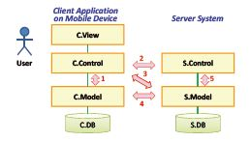
Efficiency-centric Mobile Applications

Slide 5
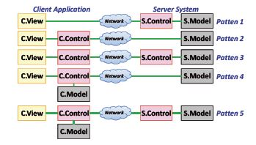
Efficiency-centric Mobile Applications

Slide 6
Data-oriented Mobile Applications
Mobile applications which depend of remote data sources are particularly challenging to develop given the limited resource availability.
This paper discusses architectures for mobile applications that require retrieval of data from remote databases.
Experiments are performed to compare the performance of two architectures.

Slide 7
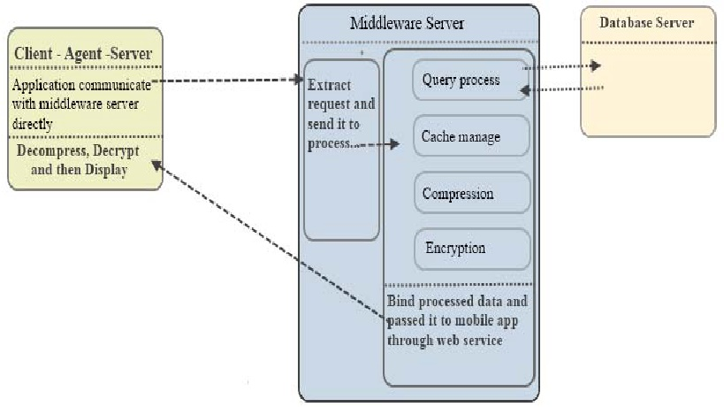
Data-oriented Mobile Applications

Slide 8
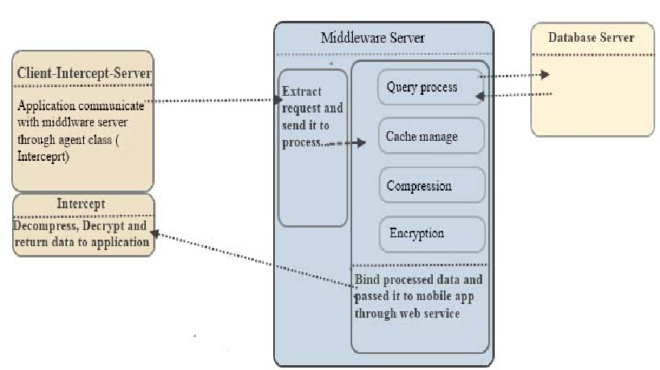
Data-oriented Mobile Applications

Slide 9
Mobile Business Applications
Business Application users prefer to access information and even make critical decisions using mobile devices.
This paper presents a Lightweight Software Architecture as a platform for Mobile Business Applications.
The framework enables business applications connected to SAP through common mobile devices.

Slide 10
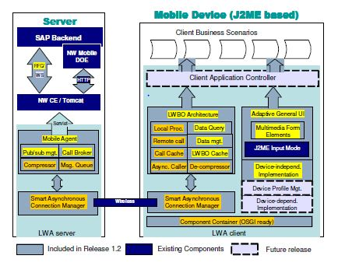
Mobile Business Applications

Slide 11
Product Lines for Mobile Applications
Product line is a set of systems sharing a common, managed suite of features.
Product lines consists of family of interrelated software applications using a pool of core assets.
Applications share many things such as software components, documents, processes and tools.

Slide 12
Mobile Browsers in Product Line
This is a case study of the development of Mobile Browsers in a Product line by Nokia.
Initially, Nokia developed a WAP browser and a toolkit.
Later, they extended the product family to include three browsers and a multimode toolkit product.
Identifying the common core components and bringing them into a product line was a challenging task.

Slide 13
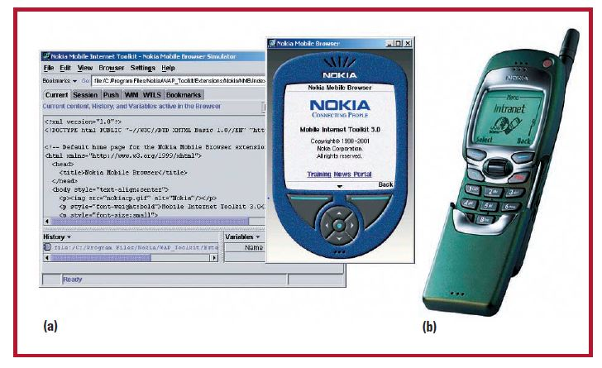
Mobile Browsers in Product Line

Slide 14
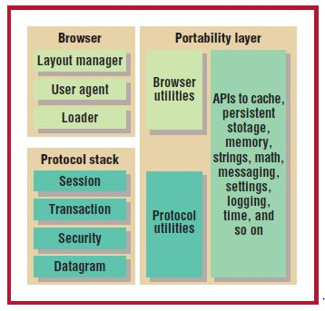
Mobile Browsers in Product Line

Slide 15
Robust SPL for Data Collection
Data collection is a domain which evolved to use mobile devices to collect information.
This requires quality properties such as reliability, availability, and data integrity.
The paper proposes a robust SPL architecture which uses Component-Based Development (CBD), Fault Tolerant Techniques and Software Product Lines (SPL) with Aspect-Oriented Software Development (AOSD).

Slide 16
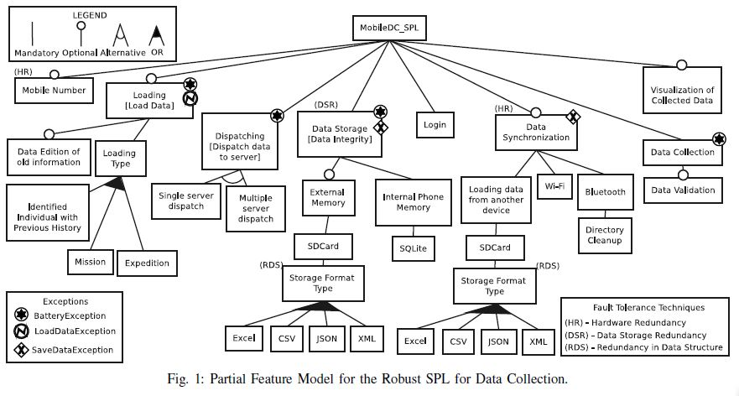
Robust SPL for Data Collection

Slide 17
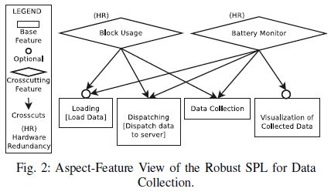
Robust SPL for Data Collection

Slide 18
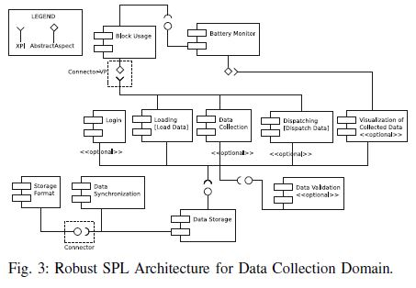
Robust SPL for Data Collection

Slide 19
Conclusion
It is imperative to identify the type of the mobile application, which is an important factor in choosing the Software Architecture.
Creating a Product Line is a long-term effort in which benefits come through reuse.
Building a few products first is the right way to initiate Product Line.

